Slide 1
Noncommunicable diseases among persons living with HIV
Andrew Carr
St Vincent’s Hospital, Sydney, Australia
Share your thoughts on this presentation with #IAS2019

Slide 2

Disclosures
Research funding/support: BMS, Gilead, Novartis and ViiV
Conference travel sponsorships: BMS, Gilead and ViiV
Advisory boards: Gilead, MSD and ViiV

Slide 3
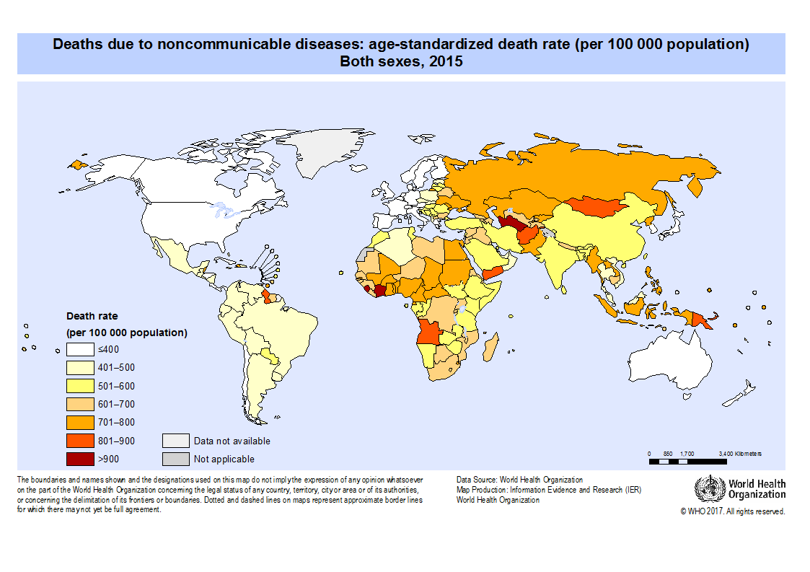
Global burden of noncommunicable diseases 2017
71% of all deaths
>85% occur in low- and middle-income countries
Disease | Deaths
All | 55,946,000
Infections | 8,413,000
AIDS | 955,000
NCDs | 41,071,000
CVD | 17,791,000
Cancer | 9,556,000
COPD | 3,198,000
Diabetes | 1,370,000
Cirrhosis | 1,323,000
CKD | 1,230,000
NCD deaths / 100,000: 2015
GBD 2017 Causes of Death Collaboration
http://gamapserver.who.int/mapLibrary/

Slide 4
Global burden of noncommunicable diseases 2017
71% of all deaths
>85% occur in low- and middle-income countries
Causes Deaths
  tobacco: 7,200,000
  salt: 4,100,000
  alcohol: 1,700,000
  inactivity: 1,600,000
Disease | Deaths | Δ2007-17 (%) | Years of life lost | Δ2007-17 (%)
All | 55,946,000 | +9.3% | 1,646,250 | -9.0%
Infections | 8,413,000 | -22.2% | 410,732
AIDS | 955,000 | -50.3% | 50,497 | -51.2%
NCDs | 41,071,000 | +22.7% | 872,602 | +13.6%
CVD | 17,791,000 | +21.2% | 330,173 | +14.7%
Cancer | 9,556,000 | +25.4% | 225,738 | +19.6%
COPD | 3,198,000 | +17.5% | 50,990 | +13.2%
Diabetes | 1,370,000 | +34.7% | 29,300 | +29.9%
Cirrhosis | 1,323,000 | +15.0% | 39,652 | +8.9%
CKD | 1,230,000 | +33.7% | 28,509 | +21.0%
GBD 2017 Causes of Death Collaboration

Slide 5
Global burden of noncommunicable diseases 2017
Women
Men
NCDs a greater cause of death than HIV after about age 25
GBD 2017 Causes of Death Collaboration

Slide 6
NCDs / comorbidities more common in HIV+
Contributions from ART for at least some NCDs / comorbidities
Obel N et al, PLoS ONE 2011

Slide 7
NCDs / comorbidities in HIV+ shorten life
NCDs / comorbidities shorten life in HIV+ adults
NCDs / comorbidities in HIV+ more common if age >50
Incidence per
1000 pyrs (95% CI)
50
Age <50
Age 50–64
Age 65+
1.0
20
Control
10
0.8
HIV+ only
5
2
0.6
HIV+ with risk factors
1
Probability of survival
0.5
0.4
0.2
HIV+ with comorbidity
0.1
0.2
HIV+ alcohol/ drug abuse
Bacterial
pneumonia
Coronary
angioplasty
Myocardial
infarction
Procedures
on other arteries
Fracture (trauma)
Fracture
(minimal trauma)
Osteoporosis
Cerebral
infarction
Pulmonary
embolism
Diabetes
Non-AIDS
cancer
0
30
40
50
60
70
Age (years)
Hasse et al. Clin Infect Dis 2011; Pourcher et al, IAS 2017

Slide 8
NCDs / comorbidities in HIV+ an increasing cause of death
Switzerland
Australia
100
90
80
70
60
50
Percentage (%)
40
30
20
10
0
1999–2002
2003–2005
2006–2008
2009–2011
2012–2014
2015–2017*
Calendar year
Non-AIDS related
AIDS related
Ruppik et al. CROI 2011; Australian HIV Observational Database annual report 2017
Notes:
Alan
On Pubmed I have found 3 studies that depict this new epidemiological scenarios
1. This tells us that there is an overlap between HANA and age related disorders with particular regards to CVD

Slide 9
Comorbidities in HIV make care more complex
 | What | Interval
Organ
CVD | ASCVD (including diabetes) | 1-2 years
 | weight gain | every visit
Renal | eGFR / U_{Prot:Cr} / other causes | 6 months
Bone | DXA / FRAX / other causes | 2-5 years
CNS | symptoms; LP / MRI if symptomatic | 12 months
Cancer | breast / bowel / lung / liver | As in HIV-
 | Pap smear | 1-2 years

Slide 10
Cardiovascular disease (CVD)
HIV+ adults: disability-adjusted life years per 100,000
Shah et al, Circulation 2018

Slide 11
Cardiovascular disease (CVD)
Observed and predicted MI rates by ART duration (D:A:D)
MI rates with darunavir
QD BID
8
Observed
7
Predicted
6
5
Rate/1000 person-yrs
4
3
2
1
0
None
< 1
1-2
2-3
3-4
> 4
cART duration (years)
Law et al, HIV Med 2006; Opsomer et al, Drugs R+D 2018

Slide 12
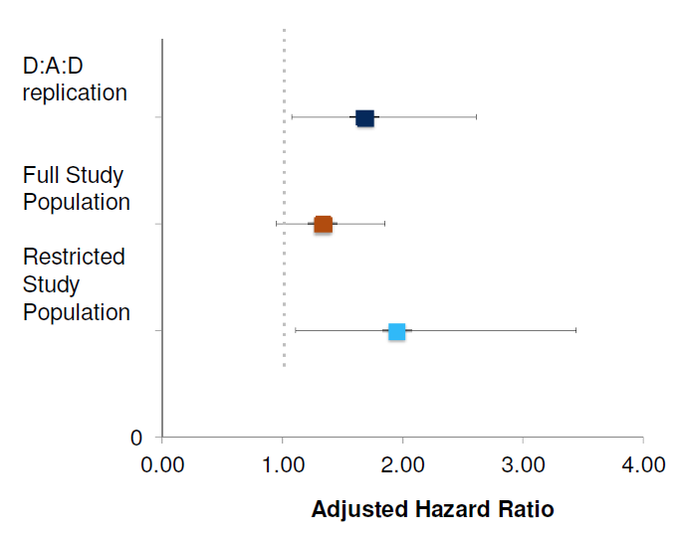
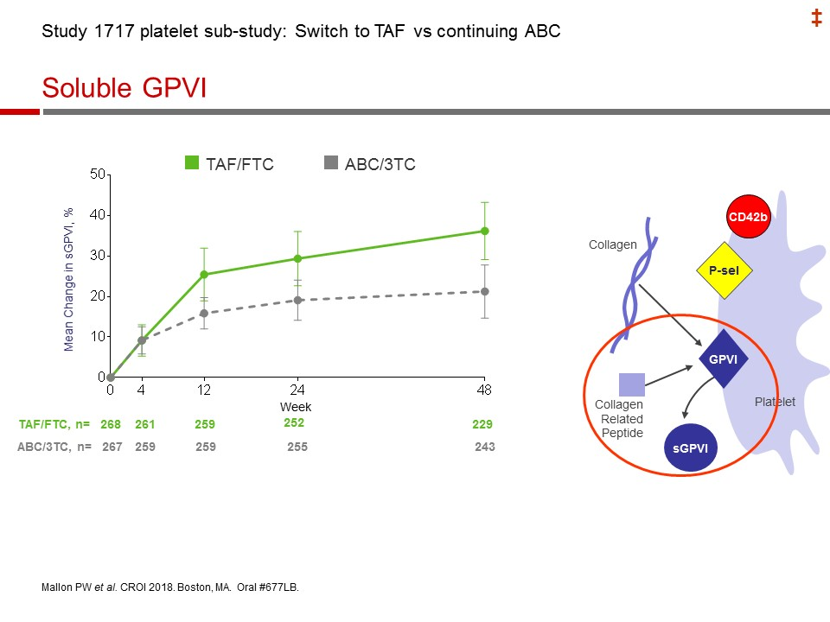
CVD: abacavir
MI risk with abacavir in younger adults (mean 35 years)
ABC-3TC switch to TAF-FTC
Relative increased risk with abacavir approximately 2-fold
Palella et al, CROI 2015; Mallon et al, CROI 2018

Slide 13
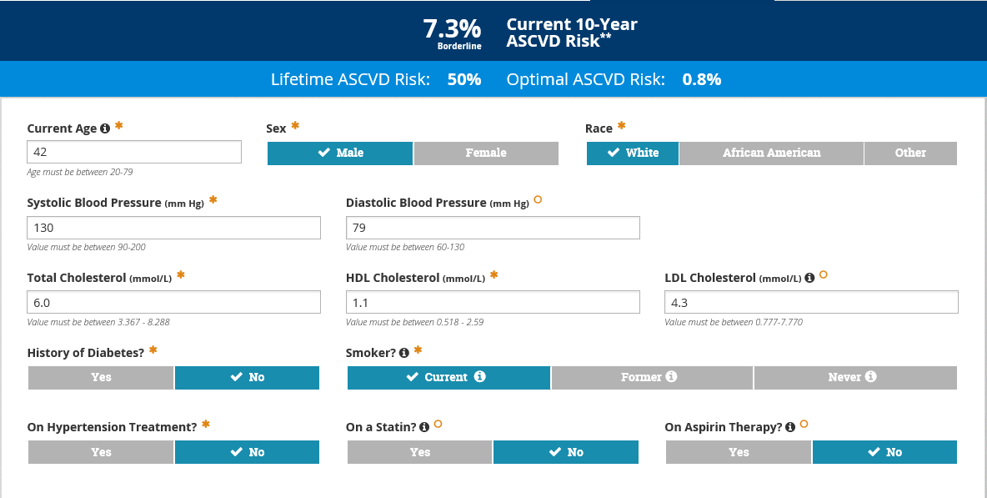
CVD: risk assessment
Framingham | DAD model | HR for MI
Age | Age (per 5 year ↑) | 1.93
Sex | Male sex | 1.34
Current smoking | Current smoking | 4.02
.. | Ex-smoking | 2.01
.. | Diabetes | 2.28
Total cholesterol | Total chol (per 1 mmol/l ↑) | 1.28
HDL cholesterol | HDL chol (per 1 mmol/l ↑) | 0.66
Systolic BP | Systolic BP (per 1 mmHg ↑) | 1.04
.. | Indinavir (per year exposed) | 1.07
.. | LPV/r (per year exposed) | 1.12
.. | Abacavir (current) | 2.04
ASCVD model
Friis-Møller et al, Eur J Cardiovasc Prev Rehabil 2009
https://www.chip.dk/Tools-Standards/Clinical-risk-scores
http://tools.acc.org/ASCVD-Risk-Estimator-Plus/#!/calculate/estimate

Slide 14
CVD management: smoking cessation
Varenicline (n=123)
5
Week 9–48
Placebo (n=124)
Week 9–37
Study period
Week 9–24
RR
Week 9–18
1
Week 9–12
Baseline status
Stopped smoking during follow-up
Never smoked
Previous
Current
<1 yr
1–2 yrs
2–3 yrs
3+yrs
0
20
40
60
80
0.5
Continuous abstinence
Petoumenos et al, J Int AIDS Soc 2012; Mercie et al, Lancet HIV 2018

Slide 15
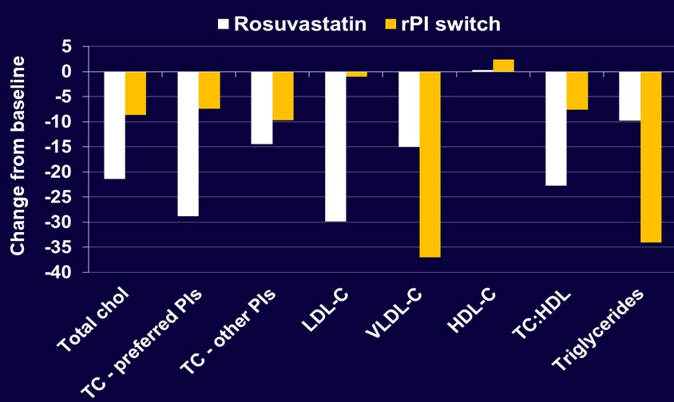
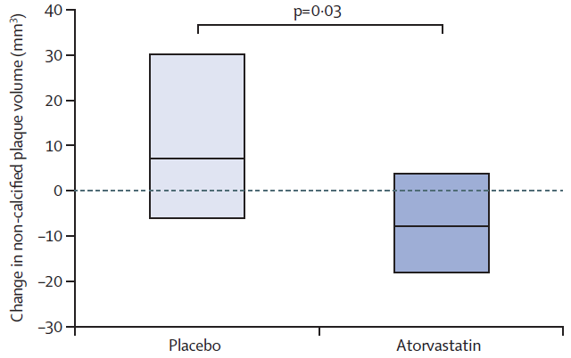
CVD management: statins and/or PIr switching
Atorvastatin vs. placebo
Rosuvastatin vs. PIr switching
Change Month 12 | Pbo | Atorvastatin 20 mg daily | P
Total chol | 0.12 | -1.23 | <0.0001
LDL chol | 0.30 | -1.00 | <0.0001
Carotid plaque volume
Lo et al, Lancet HIV 2015
Lee et al, HIV Med 2016

Slide 16
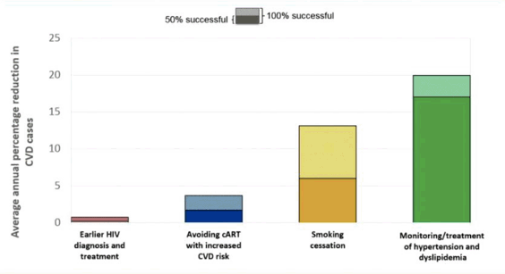
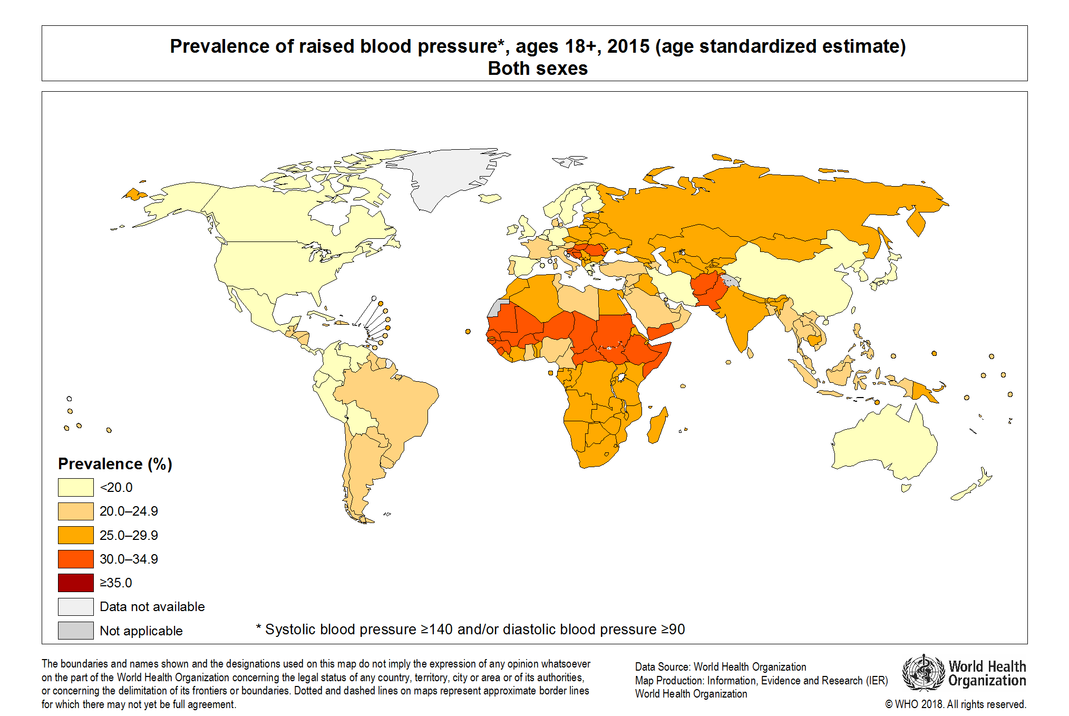
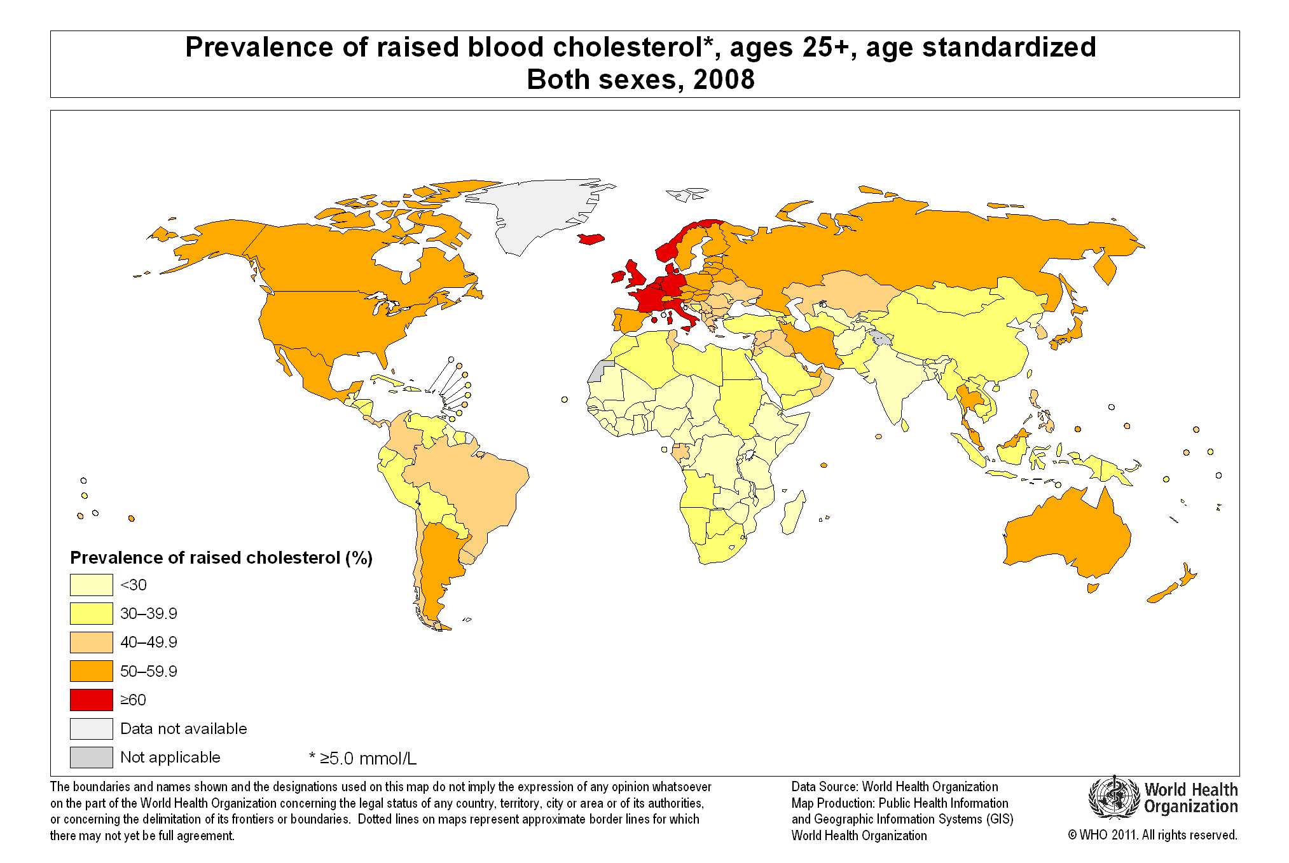
CVD: ART modification vs. traditional risk factors
Hypertension
systolic BP >140 or diastolic BP >90mmHg
Total cholesterol >5mmol/L
van Zoest et al, JAIDS 2019; http://gamapserver.who.int/mapLibrary/

Slide 17
Obesity
1.9 billion adults (39%) are overweight (BMI >25 kg/m²)
650 million (13%) are obese (BMI >30)
Health risks
  ≈30% increased risk of death per 5kg/m² greater
  similar results for all global regions
  hazard ratios greater for
    men (50%) vs women (30%)
    age <50 (52%) vs. 50-69 (37%) vs. 70-89 (21%)
  More CVD, diabetes, arthritis, some cancers
https://www.who.int/news-room/fact-sheets/detail/obesity-and-overweight
Global BMI Mortality Collaboration, Lancet 2016

Slide 18
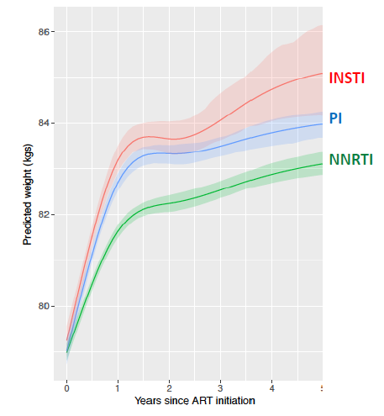
Weight gain and INSTIs: initial ART
Study 1490
Study 1489
86
84
82
80
  n=4,093
Predicted Weight (kg)
  n=7,063
  n=10,711
Predicted Weight Change (kg)
 | NNRTI | PI | INSTI
Year 2 | 3.3 | 4.3 | 4.4
Year 5 | 4.1 | 5.0 | 5.8
0 1 2 3 4 5
Years Since ART Initiation
Stellbrink et al, Lancet HIV 2019; Wohl et al, Lancet HIV 2019; Lake et al, HIV ADR workshop 2018

Slide 19
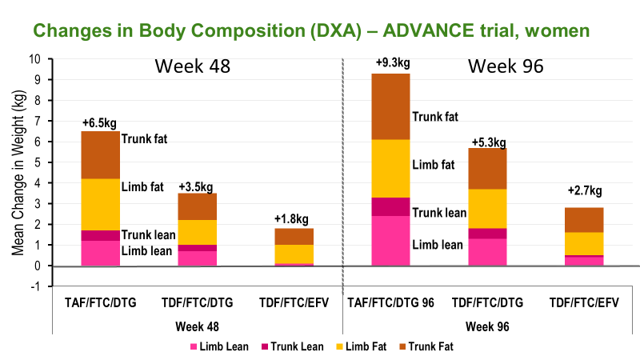
Weight gain and INSTIs: body composition
ADVANCE (women)
Similar results for men, although increments smaller
Wide confidence intervals
Outcomes after Year 2?
TAF minus TDF
DTG minus EFV
Hill et al, IAS 2019

Slide 20
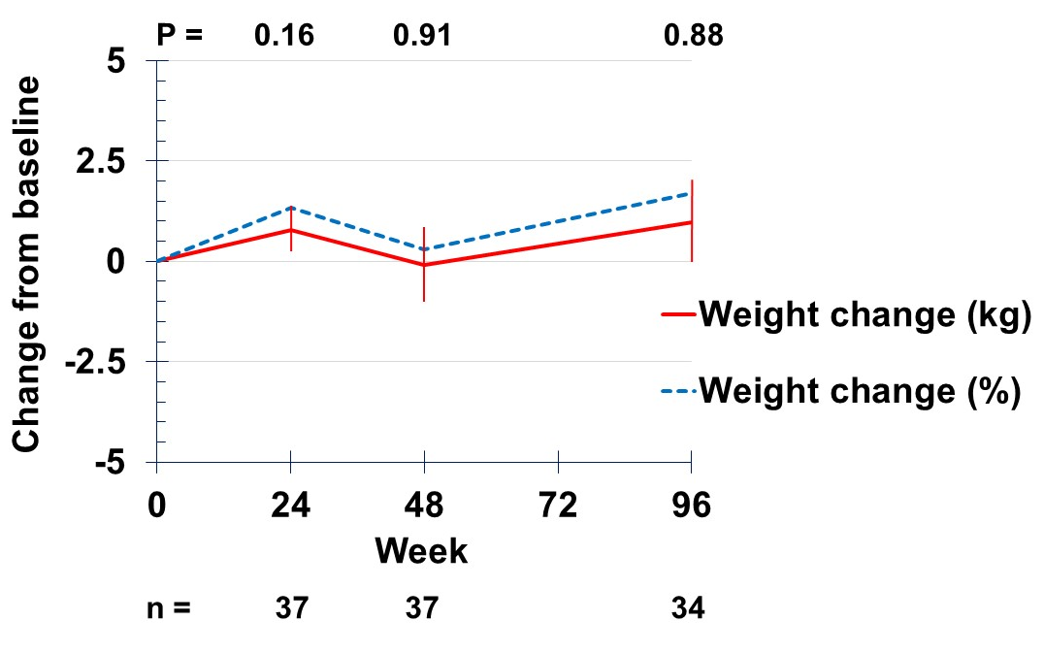
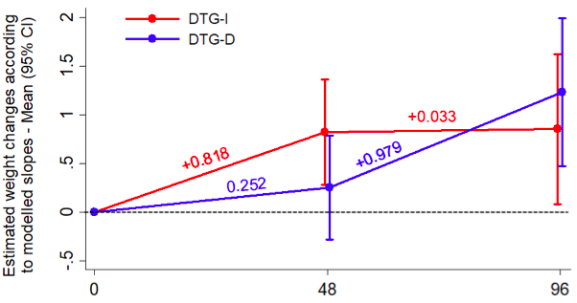
Weight gain and INSTIs: switch trials
PIr to DTG switch (NEAT022)
TDF to RAL switch (TROP)
Note confidence intervals
Week
Martinez et al, Glasgow 2018; Carr et al, IAS 2019

Slide 21
Weight gain and INSTIs: potential significance
Average Australian man 2011 (1.76m, 86kg, BMI 27.8)
Starts INSTI, weight gain of
  2kg = BMI → to 28.5kg/m²
  5kg = BMI → to 29.4kg/m²
  8kg = BMI → to 30.3kg/m²
Mechanism?
Risk factors for larger gains?
Will this lead to more CVD, diabetes, arthritis, and cancer?
Global BMI Mortality Collaboration, Lancet 2016

Slide 22
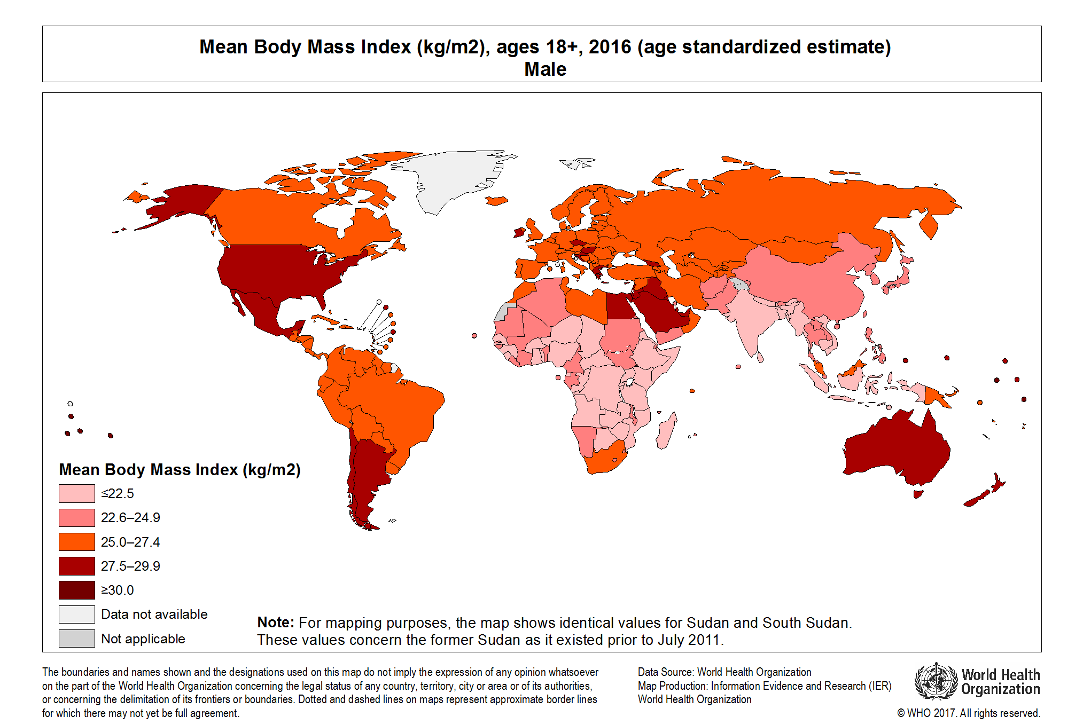
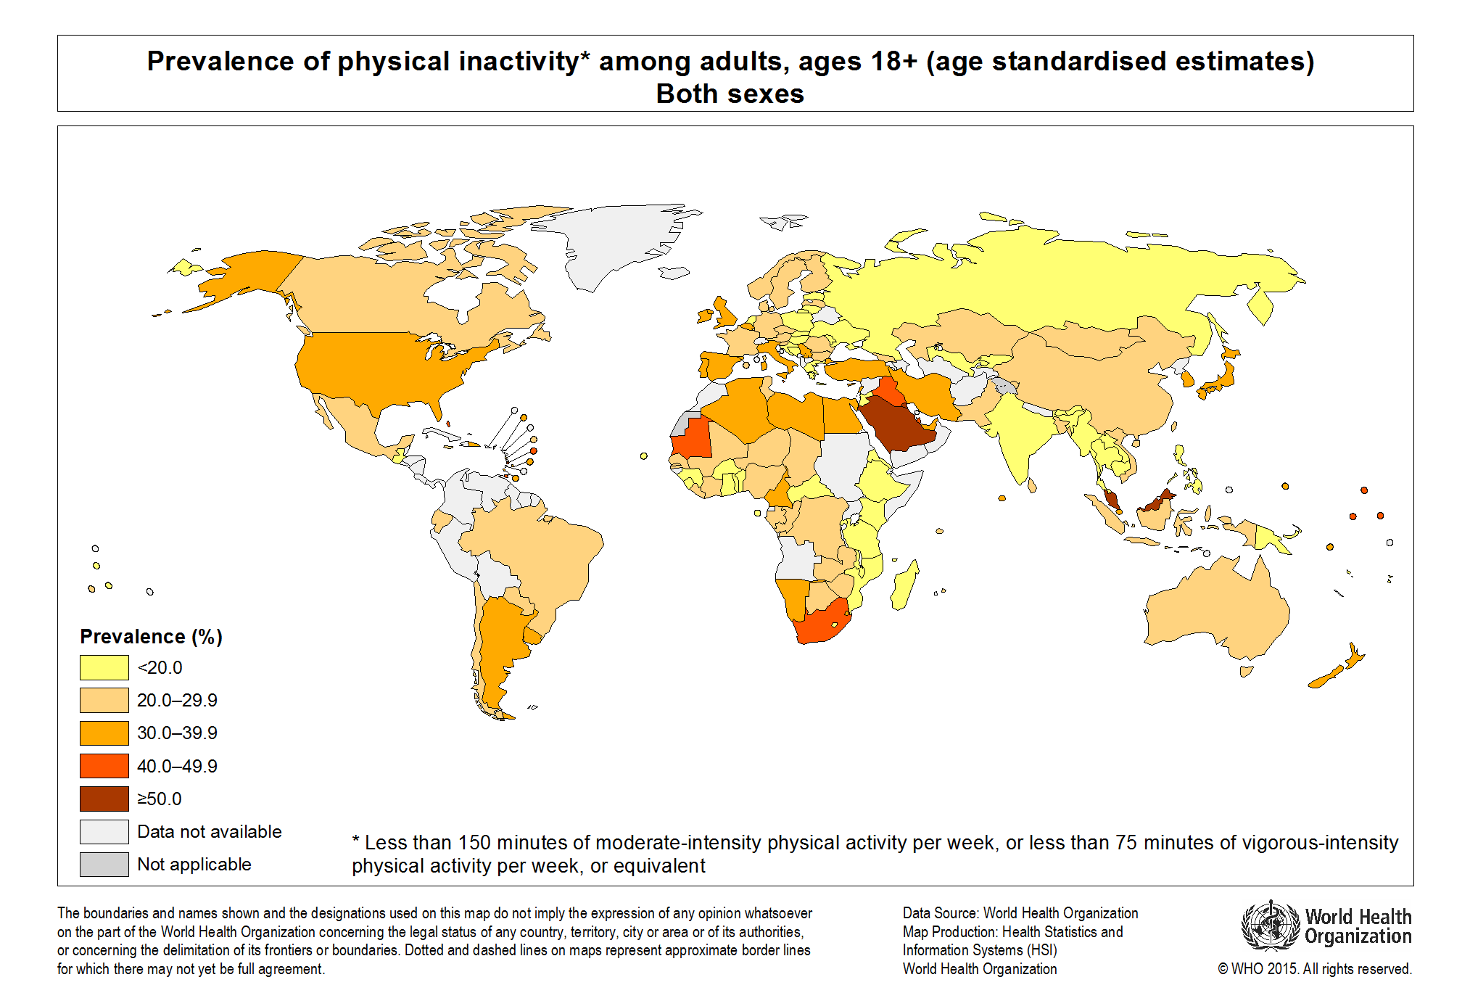
Obesity: WHO strategies
Less energy-dense foods
  fruit + vegetables >5 / day
  total fat <30% of calories
  free sugars <10% of calories
  salt <5g / day
Increase physical activity
  reduce sedentary work
  change transport
  reduce traffic / air pollution
  more public exercise space
BMI 2016
Physical inactivity 2010
WHO, Global Action Plan 2013-2020
http://gamapserver.who.int/mapLibrary/

Slide 23
Cancer
NHL (and KS) only reduced with ART
Effective HBV / HPV vaccines
Effective HBV / HCV therapies
+
Routine screening
Disease | Deaths | Δ2007-17 (%) | Years life lost | Δ2007-17 (%)
All | 55,946,000 | +9.3% | 1,646,250 | -9.0%
Cancer | 9,556,000 | +25.4% | 225,738 | +19.6%
Lung | 1,883,000 | +29.6% | 40,392 | +24.8%
Colorectal | 896,000 | +27.8% | 18,107 | +23.8%
Stomach | 865,000 | +9.4% | 18,782 | +4.8%
Liver | 819,400 | +27.0% | 20,536 | +21.2%
HBV | 325,400 | +20.3% | 9,449 | +14.7%
HCV | 234,300 | +30.4% | 4,898 | +26.9%
Breast | 611,600 | +27.0% | 16,401 | +23.9%
Oesophagus | 436,000 | +13.0% | 9,848 | +8.9%
Cervical | 259,700 | +18.8% | 1,930 | +14.8%
NHL | 248,600 | +29.4% | 6,829 | +22.1%
GBD 2017 Causes of Death Collaboration

Slide 24
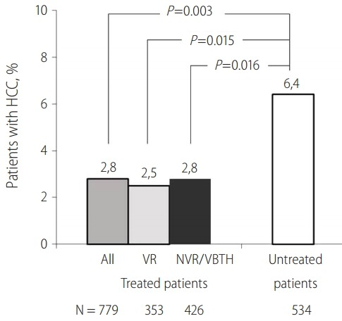
Hepatocellular carcinoma secondary to HBV / HCV
HCC incidence after
HBV therapy
HCC incidence after HCV DAA therapy (n=60,611)
 | Incidence (per 100 patient-years)
HCV treatment
SVR | 2.1 (1.4, 3.4)
no SVR | 9.1 (5.4, 15.3)
No HCV treatment | 13.2 (4.5, 38.6)
Varbobitis et al, Clin Mol Hepatol 2015
Huang et al, Carcinogenesis 2018

Slide 25
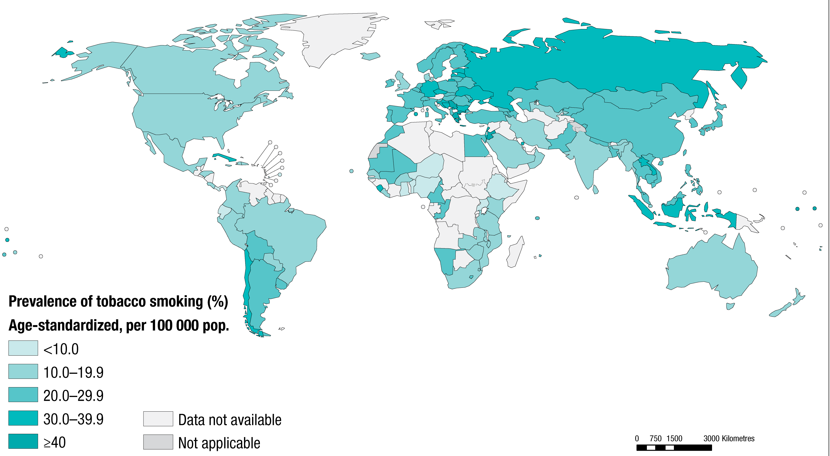
Chronic Obstructive Pulmonary Disease (COPD)
Global burden 251,000,000
  >90% in LMICs
Global deaths 3,170,000
Causes
  smoking (including 2nd-hand)
  air pollution (indoor and outdoor)
  occupational dusts and fumes
Tobacco smoking in adults, 2015
http://gamapserver.who.int/mapLibrary/

Slide 26
COPD
COPD more common in HIV
In HIV, COPD aggravated by:
  more smoking
  more bacterial chest infections
  PJP
  but not HIV itself
 | FEV slope (mL/yr) |  | P
 | Immediate ART | Deferred ART
Overall | -29.1 | -24.5 | 0.64
Smokers | -32.9 | -29.7 | 0.86
Non-smokers | -27.8 | -22.2 | 0.65
Crothers et al, Chest 2006
Kunisaki et al, Lancet Respir Med 2016

Slide 27
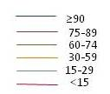
Chronic kidney disease
Risk of death
Incidence (TDF)
1.1 (0.9–1.2) / 100 PYFU
0.60
0.45
% progressed
Probability of death
0.30
0.15
0
0
6
12
Years
Kirk et al 2010

Slide 28
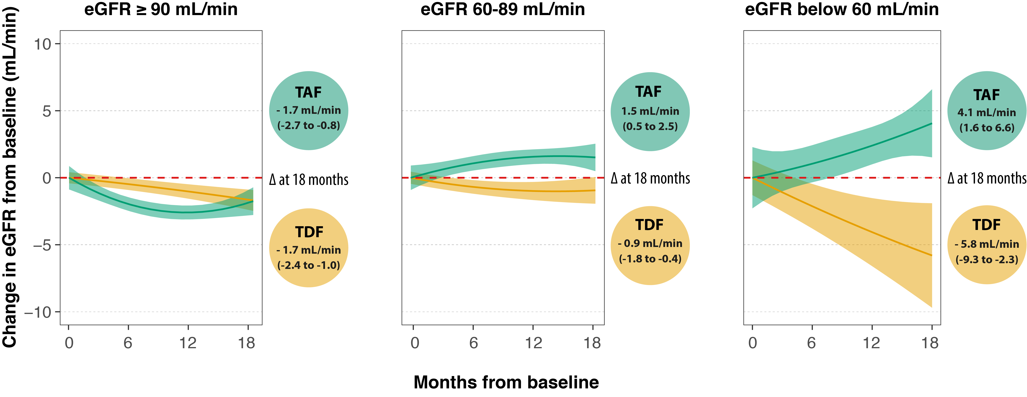
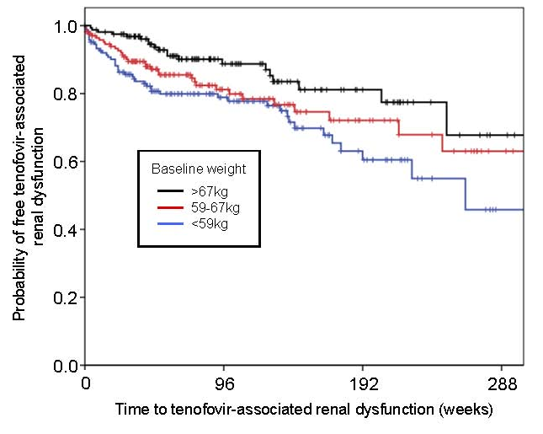
Chronic kidney disease: role of TDF
TDF effect
more likely with lower weight
limited recovery
Nishijima et al, PLoS ONE 2012; Surial et al, IAS 2019

Slide 29
Chronic kidney disease: management
Ensure patient hydrated when measuring GFR
Avoid nephrotoxic drugs e.g. diclofenac
Treat CKD risk factors e.g. hypertension, diabetes, HCV, HBV
Rapid, artefactual “decline” in eGFR after INSTI initiation
Declining eGFR more likely due to TDF if
  glycosuria +
  urinary phosphate +
  other renal risk factors not present
Stop TDF if eGFR persistently <70 – many TDF-sparing regimens

Slide 30
Low bone density / fractures
5.0
HIV+; n=2489
HIV-neg; n=1118587
4.5
Drug or drug class | Multivariable analysis
 | HR per year exposure (95% CI) | P
TDF | 1.12 (1.03-1.21) | 0.011
ABC | 0.95 (0.87 -1.03) | 0.19
AZT / d4T | 0.99 (0.94-1.04) | 0.60
PI/r | 1.05 (0.97-1.13) | 0.24
NNRTI | 0.98 (0.92-1.03) | 0.39
TDF + PI/r | 1.16 (1.04, 1.30) | <0.01
4.0
3.5
3.0
Hip Fractures / 1000 pt-Yrs
2.5
2.0
1.5
1.0
0.5
0
40-45
45-50
50-55
55-60
60-65
65-70
70-75
75-80
Age (yrs)
Bedimo et al, AIDS 2012
Güerri-Fernandez et al. J Bone Miner Res 2013

Slide 31
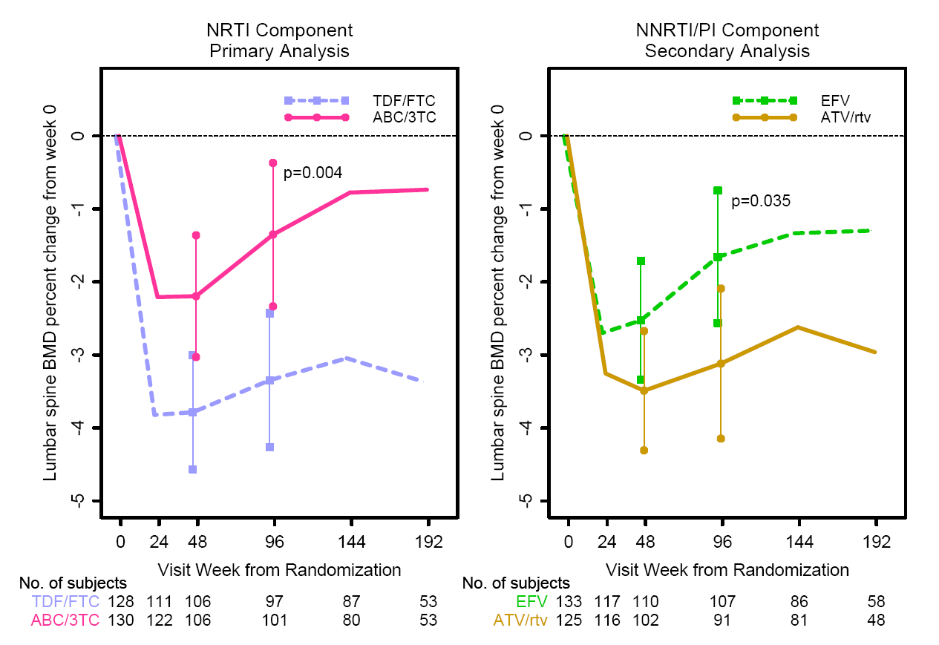
Low bone density / fractures
Initial ART lowers BMD
TDF vs. ABC NNRTI vs. PIr
TDF-3TC-EFV in >70% of participants
Carr et al, HIV Med 2019; McComsey et al, AIDS 2011

Slide 32
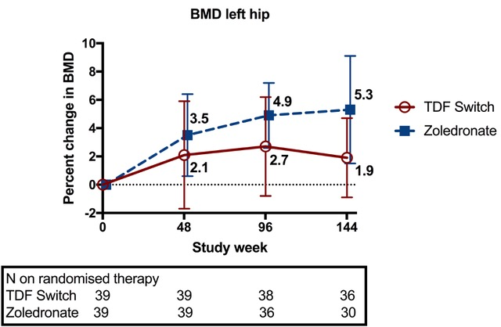
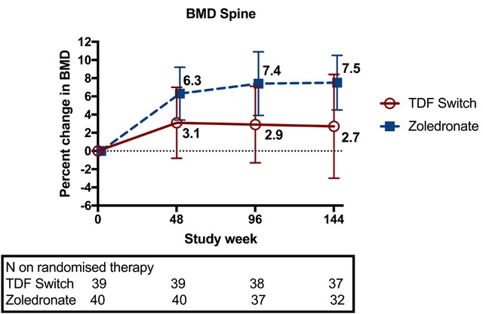
Low bone density / fractures: management
Risk estimation (FRAX)
Zoledronate vs TDF switch
Fractures | ZOL | TDF switch | P-value
Events | 3 | 10 | 0.04
Subjects | 2 (5%) | 6 (14%) | 0.16
Carr et al, JBMR (in press)

Slide 33
NCDs: WHO’s “best buys”
Reduce | Interventions costing <$100 per DALY averted in LMICs
Tobacco use | Increase taxes Plain paper packaging Bans on advertising / promotion / sponsorship Ban indoor (second-hand) smoking (1,200,000 deaths) Education
Harmful use of alcohol | Increase taxes Bans on advertising Reduce availability
Unhealthy diet | Reduce salt in purchased and provided food Education Packaging labels listing salt levels
Physical inactivity | Education

Slide 34
Conclusions
NCD | Deaths 2017 | Switch ART | Treatment(s)
CVD | 17,791,000 | ABC, PIr (except AZV, DRV qd) | Smoking cessation, potent statin, blood pressure, diabetes
Obesity | .. | INSTIs? | None
Cancer | 9,555,000 | No | Routine screening + HBV / HPV vaccination, HBV / HCV therapy, immediate ART
COPD | 3,198,000 | No | Smoking cessation
Cirrhosis | 1,323,000 | No | HBV vaccine HBV / HCV treatment
CKD | 1,230,000 | TDF (eGFR>70) | Blood pressure and diabetes
Fractures | .. | TDF | Bisphosphonate Treat secondary causes

Slide 35
Conclusions
NCD | Deaths 2017 | Switch ART | Treatment(s) | WHO’s “Best Buys”
CVD | 17,791,000 | ABC, PIr (except AZV, DRV qd) | Smoking cessation, potent statin, blood pressure, diabetes | Less fat / salt / sugar
Obesity | .. | INSTIs? | None | Calorie restriction More exercise
Cancer | 9,555,000 | No | Routine screening + HBV / HPV vaccination, HBV / HCV therapy, immediate ART | Smoking and alcohol restrictions
COPD | 3,198,000 | No | Smoking cessation | Smoking restrictions
Cirrhosis | 1,323,000 | No | HBV vaccine HBV / HCV treatment | ..
CKD | 1,230,000 | TDF (eGFR>70) | Blood pressure and diabetes | Less salt / sugar
Fractures | .. | TDF | Bisphosphonate Treat secondary causes | ..

Slide 36
Conclusions
NCDs in HIV+ patients with controlled HIV consist of more than ART/HIV comorbidities and cause far more deaths
Most NCD deaths in adults with controlled HIV will have little to do with ART and much more to do with traditional / lifestyle factors
So NCD prevention in HIV+ adults on effective ART requires assessment of traditional risk factors (including at the population level) and of ART
Switching ART without addressing traditional NCD risk factors is poor medicine

Slide 37
Thank you
Alexandra Calmy / Hill
Bernard Surial

